Slide 1



Presentation on BDM Capstone Project Topic : Fresh Insights: Revitalizing Sandeep Vegetable Shop through Effective Data Management and Solutions.
BY-ULLAS KUMAR
Roll : 21F3002619
Under the guidance of
BDM Course instructor
BS DATA SCIENCE AND APPLICATIONS

Slide 2
Outline:
▶ About Sandeep vegetable shop business
▶ Problem Statement
▶ Analysis on sales data of vegetables
▶ Analysis on inventory data of vegetables
▶ Analysis on shelf life problem

Slide 3
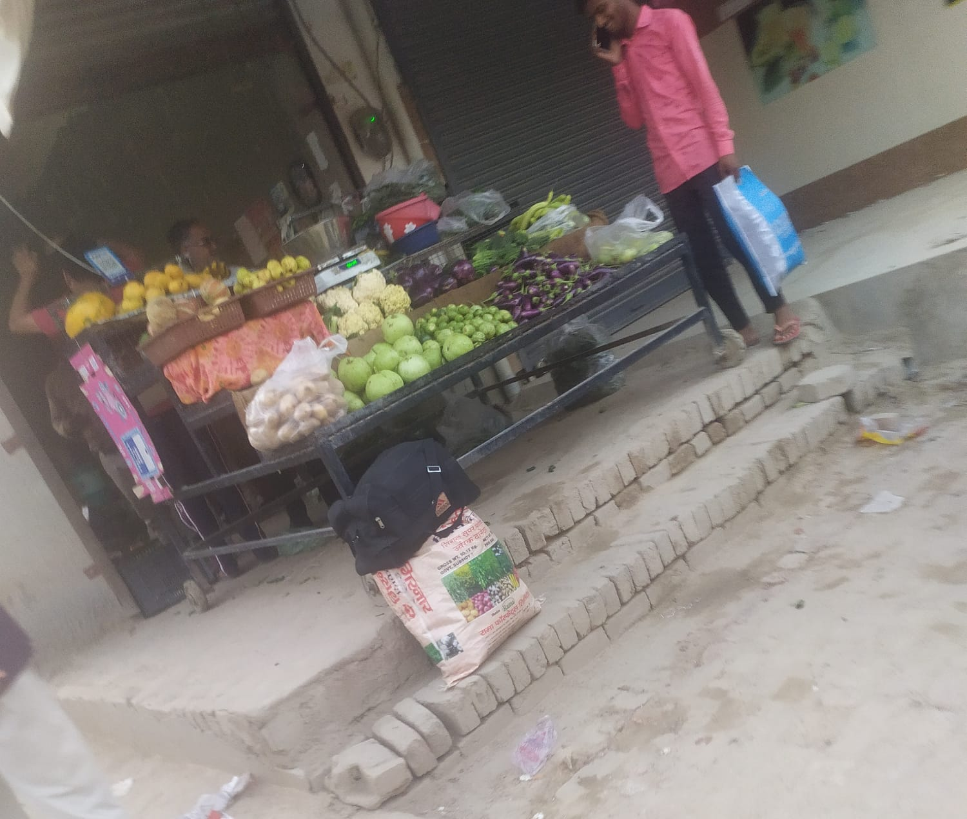
About Sandeep vegetable shop business:
Sandeep is a owner of vegetable shop in village Chunawadh. He sells different types of vegetables.

Slide 4


Problem statement:
▶ How to maintain inventory of vegetables to maximise profits?
▶ How to increase overall sales of vegetables?
▶ Which vegetables have lower shelf life and how to increase it?

Slide 5
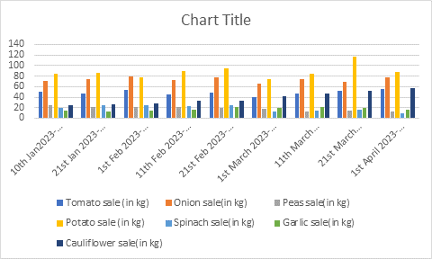
Analysis on sales data of vegetables:
▶ The below bar graph shows the sales of different vegetables during three month period-
▶Best-selling vegetables of Sandeep vegetable shop: Potatoes and onions are the most popular vegetables sold at Sandeep Vegetable Shop, with consistently high sales recorded throughout all the weeks. Conversely, spinach and peas have the lowest sales, indicating low demand for these vegetables among the customers of Sandeep vegetable shop.

Slide 6
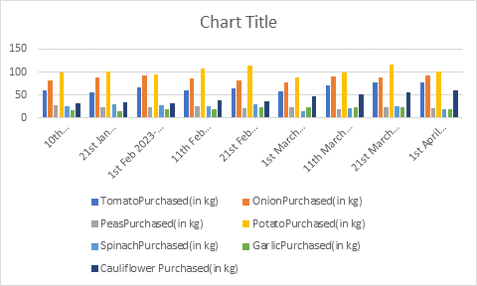
Analysis on inventory data of vegetables:
▶ The below bar graph shows the inventory of different vegetables during three month period-
▶ Sandeep's purchasing habits for different vegetables were analyzed across different time periods. Tomatoes and onions were consistently high in quantity, with the highest amount of tomatoes purchased from 10th Jan 2023-20th Jan 2023. Peas and spinach had relatively lower quantities purchased, and potatoes had the highest consistently purchased amount. Garlic showed an increase in quantity during 1st March 2023-10th March 2023, and cauliflower had a significant increase in quantity from 11th Feb 2023-20th Feb 2023 and remained relatively consistent thereafter.

Slide 7
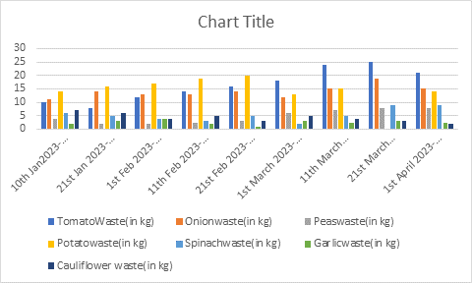
Analysis on shelf life data of vegetables:
▶ The below bar graph shows the inventory of different vegetables during three month period-
▶Sandeep vegetable shop needs to improve their storage and handling practices for most of the vegetables, especially for tomatoes, onions, peas, and potatoes, which have a higher amount of waste during different periods. This vegetable shop seems to be doing well in their handling and storage practices for garlic and cauliflower, as the amount of waste is consistently low for these vegetables. Overall, reducing waste can lead to cost savings and improve the environmental sustainability and profitability of the vegetable shop.

Slide 8
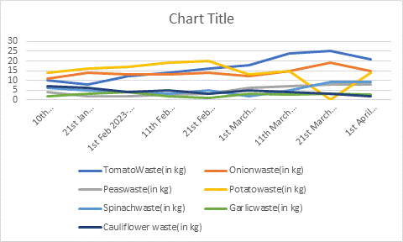
▶ Let’s have another view of how much wastage of a vegetable is generated across three months period:
▶ This can be seen clearly from graph that as the summer season approaches, wastage of almost all the vegetabales increases.
▶ This study on waste generation of different vegetables during different periods reveals that tomatoes have the highest waste generation with 109 kg over a 90-day period, followed by onions and peas. Potatoes also generate significant waste, indicating that the vegetable shop needs to improve their storage and handling practices for these vegetables. However, garlic and cauliflower have consistently low waste generation, indicating good handling and storage practices. The vegetable shop needs to focus on reducing waste to save costs and improve sustainability.

Slide 9
Recommendation:
▶ Focus on high-selling vegetables: Based on sales data, Sandeep Vegetable Shop should increase the inventory of high-selling vegetables like potatoes and onions to meet customer demand. By stocking up on these items, they can ensure that they do not run out of stock and can maintain customer satisfaction.
▶ Reduce inventory of low-selling vegetables: To free up space and resources, the shop should reduce the inventory of low-selling vegetables like spinach and peas. This will help them to optimize their inventory and prioritize items with higher demand.
▶ Analyze and adjust sales strategies: Sandeep Vegetable Shop should analyze sales data regularly to identify trends and adjust sales strategies accordingly. For instance, they can offer discounts or promotions on average-selling vegetables like tomatoes to boost sales and attract new customers.
▶ Improve storage and handling: The shop should train its staff on proper handling and storage of vegetables to reduce waste and optimize shelf life. By improving storage conditions and avoiding overhandling during transportation, they can reduce spoilage and increase profitability.
▶ The shop owner can collaborate with local farmers to source fresh and seasonal vegetables, which can help to attract customers and increase sales. This can also help to reduce transportation costs of the shop.
Link for detailed report: Detailed final report

